Slide 1




Slide 2
CS103 Discrete Structures Zagazig university Faculty of computers and informatics Department of Computer Science Dr. Abduallah Gamal

Slide 3
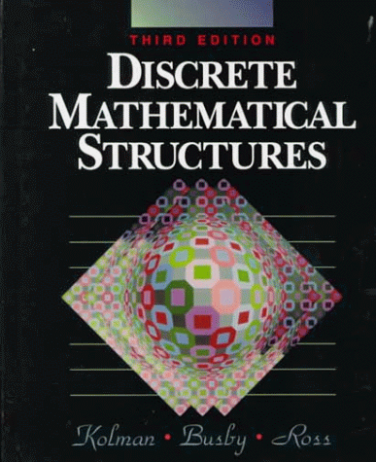
Lectures Reference
Discrete Mathematical Structures

Slide 4
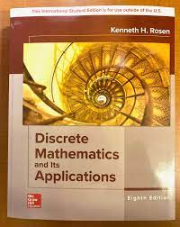
Lectures Reference
Discrete Mathematics and its Applications

Slide 5
Course Objectives
Developing rigorous treatment.
Developing mathematical foundations to CS.
Learn how to think mathematically.
Grasp the basic logical and reasoning mechanisms of mathematical thought.
Acquire logic and proof as the basics for abstract thinking.
Improve problem solving skills.
Grasp the basic elements of induction, recursion, combination and discrete structures.

Slide 6
DM is a Gateway Course
Topics in discrete mathematics will be important in many courses that you will take in the future:
Computer Science: Computer Architecture, Data Structures, Algorithms, Programming Languages, Compilers, Computer Security, Databases, Artificial Intelligence, Networking, Graphics, Game Design, Theory of Computation, ……
Mathematics: Logic, Set Theory, Probability, Number Theory, Abstract Algebra, Combinatorics, Graph Theory, Game Theory, Network Optimization, …
Other Disciplines: You may find concepts learned here useful in courses in philosophy, economics, linguistics, and other departments.

Slide 7
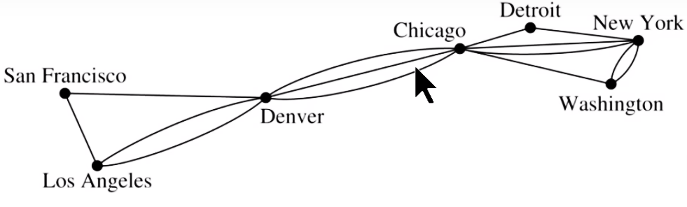
Graphs

Slide 8
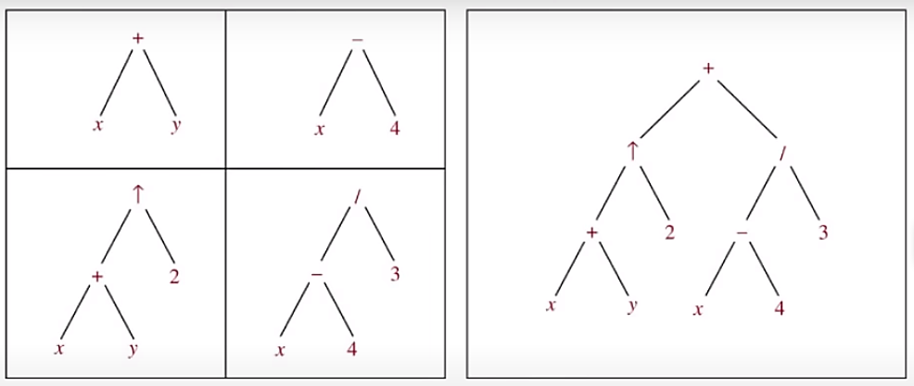
Trees

Slide 9
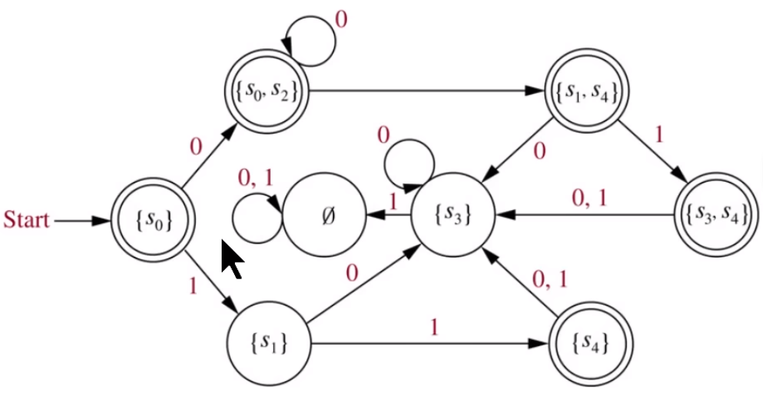
Modelling Computation

Slide 10
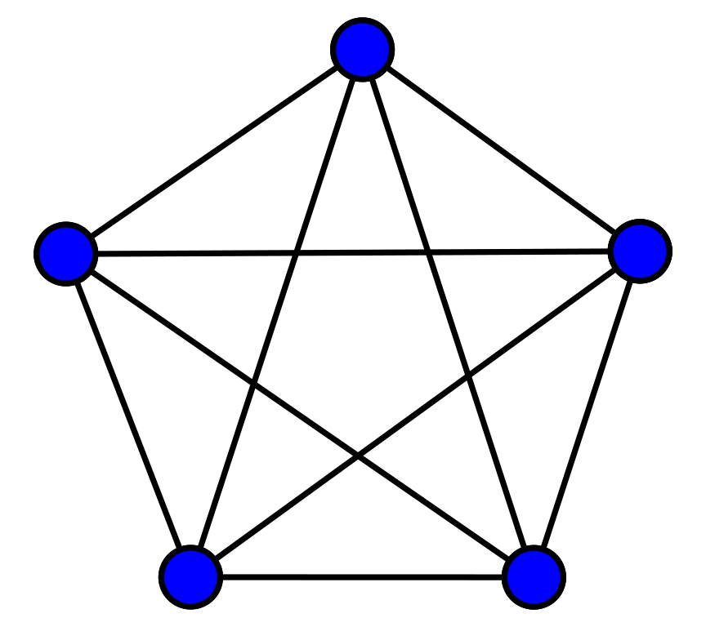

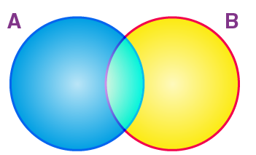
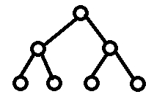
Discrete mathematics
Discrete mathematics is a part of mathematics devoted to the study of discrete objects, such as:
Set theory
Logic
Relations and digraphs
Probability theory
Graph theory
Trees
The course of discrete mathematics provides the mathematical background needed for all subsequent courses in computer science.

Slide 11

Course Syllabus
Set theory
Logic
Relations and digraphs
Probability theory
Graph theory
Trees

Slide 12
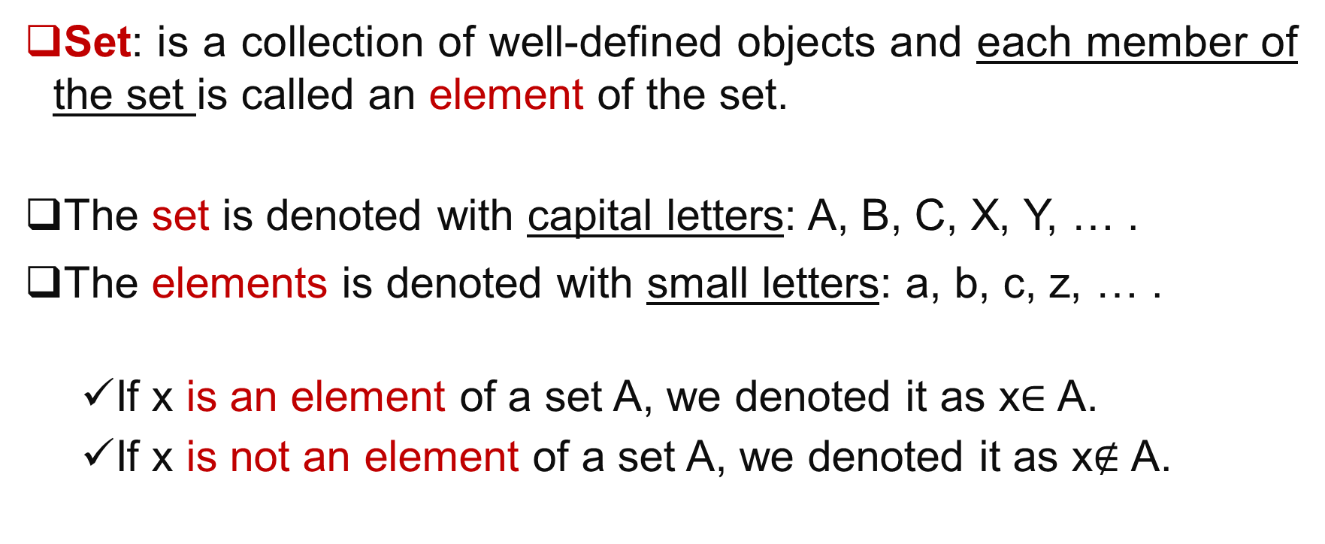
Set theory
Set: is a collection of well-defined objects and each member of the set is called an element of the set.
The set is denoted with capital letters: A, B, C, X, Y, … .
The elements is denoted with small letters: a, b, c, z, … .
If x is an element of a set A, we denoted it as x$∈$ A.
If x is not an element of a set A, we denoted it as x$∉$ A.

Slide 13
Set theory
Cardinality of a set is the number of elements in the set. Given a set S, then the cardinality of this set is denoted by #(S) or |S| or n(S).
Example: consider the set A={1,2,3,5,7}, then the cardinality of a set is |A|=5.

Slide 14
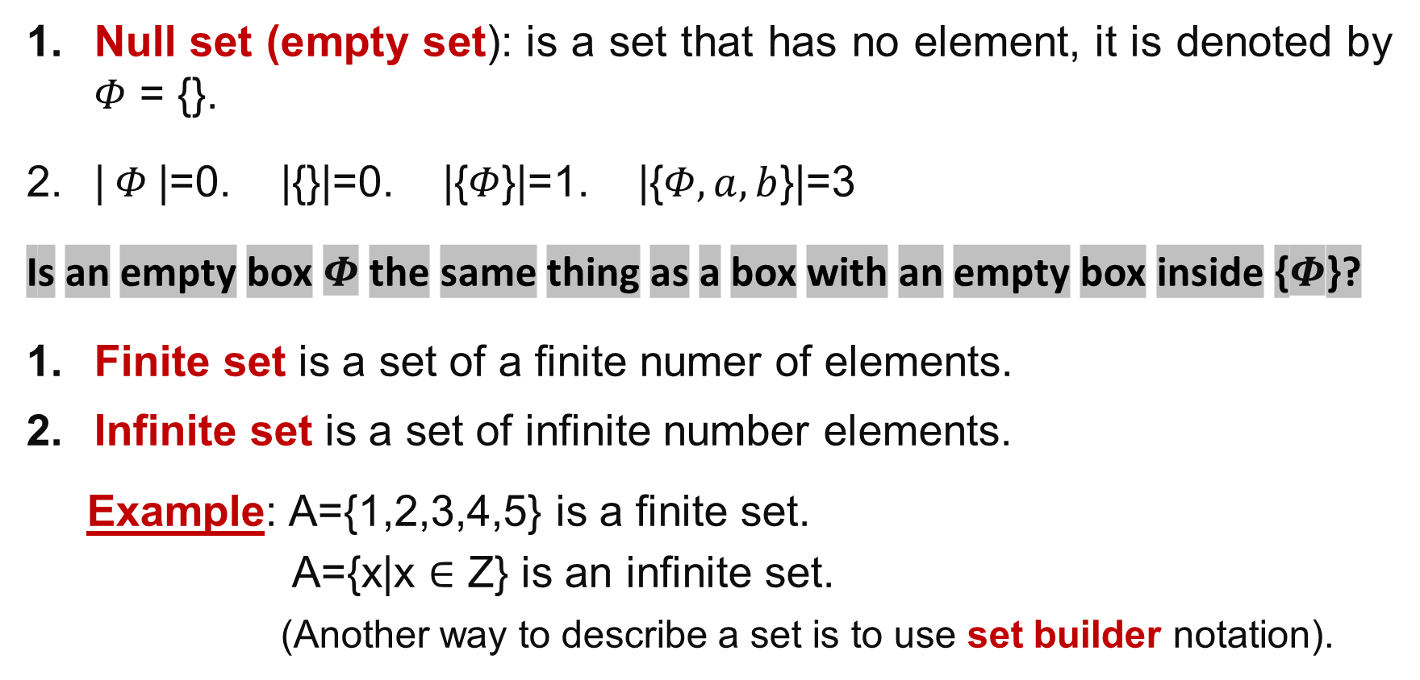
Types of set
Null set (empty set): is a set that has no element, it is denoted by $Φ$ = {}.
| $Φ$|=0. |{}|=0. |{$Φ$}|=1. |{$Φ,a,b$}|=3
Is an empty box $Φ$ the same thing as a box with an empty box inside {$Φ$}?
Finite set is a set of a finite numer of elements.
Infinite set is a set of infinite number elements.
Example: A={1,2,3,4,5} is a finite set.
A={x|x $∈$ Z} is an infinite set.
(Another way to describe a set is to use set builder notation).

Slide 15
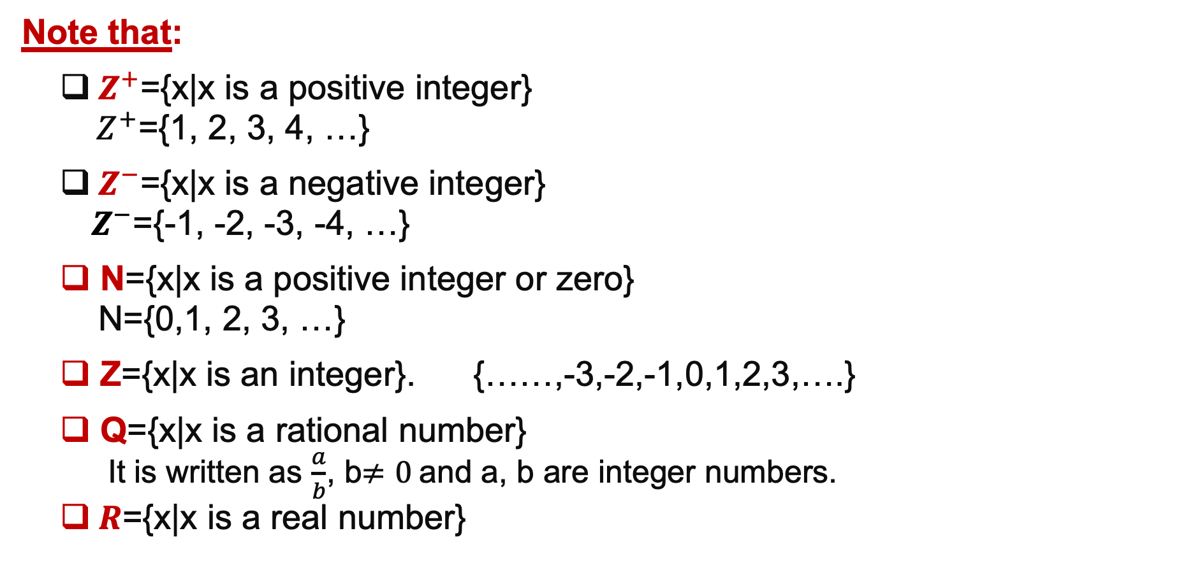
Set
Note that:
$Z^{+}$={x|x is a positive integer}
$Z^{+}$={1, 2, 3, 4, …}
$Z^{−}$={x|x is a negative integer}
$Z^{−}$={-1, -2, -3, -4, …}
N={x|x is a positive integer or zero}
N={0,1, 2, 3, …}
Z={x|x is an integer}. {……,-3,-2,-1,0,1,2,3,….}
Q={x|x is a rational number}
It is written as $\frac{a}{b}$, b$≠0$and a, b are integer numbers.
$R$={x|x is a real number}

Slide 16
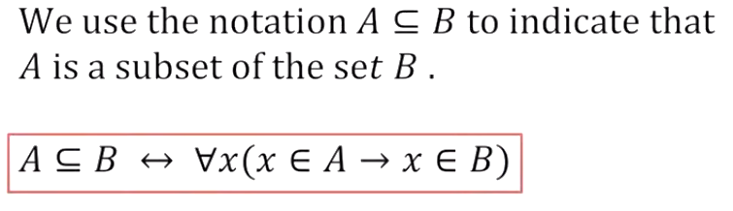
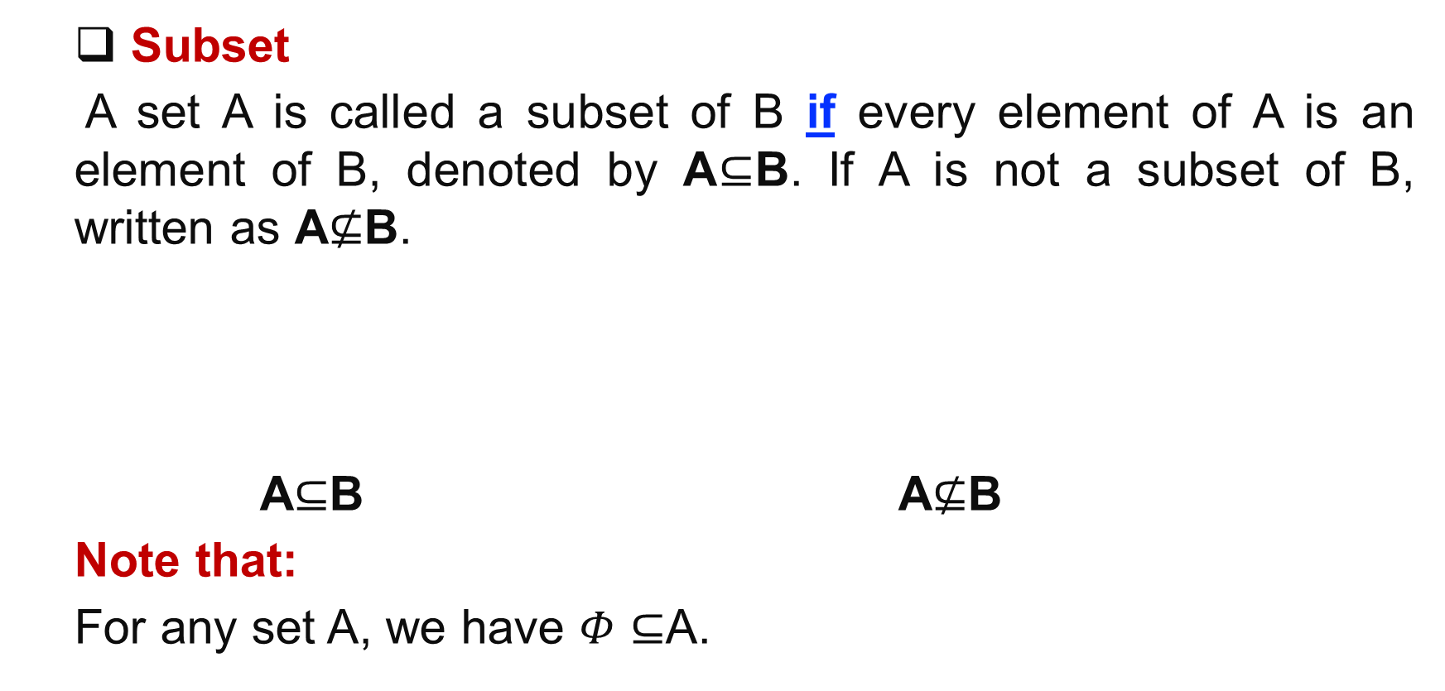
Subset
Subset
A set A is called a subset of B if every element of A is an element of B, denoted by A$⊆$B. If A is not a subset of B, written as A$⊈$B.
A$⊆$B A$⊈$B
Note that:
For any set A, we have $Φ⊆$A.
B
B
A
A
Venn diagrams

Slide 17
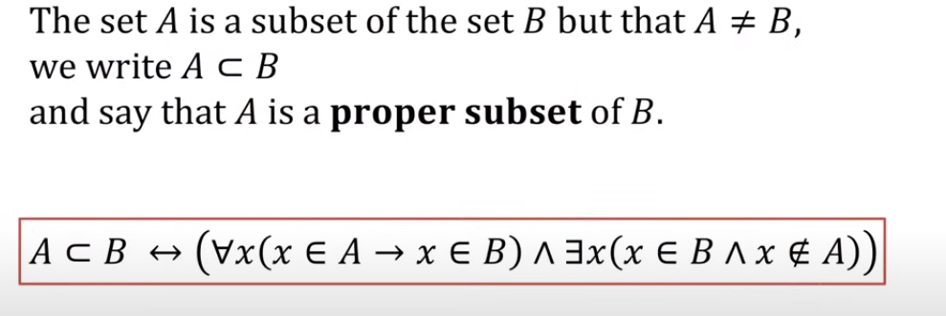
Proper Subset

Slide 18
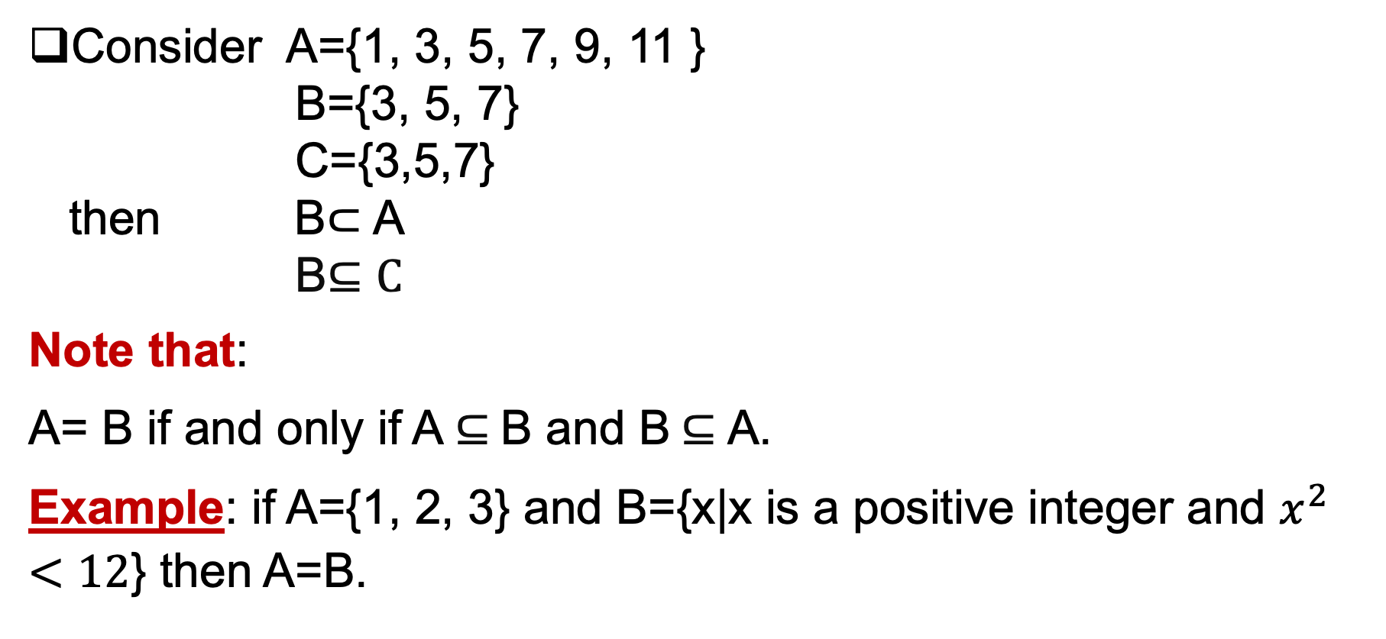
Subset and Proper Subset
Consider A={1, 3, 5, 7, 9, 11 }
B={3, 5, 7}
C={3,5,7}
then B$⊂$ A
B$⊆C$
Note that:
A= B if and only if A $⊆$B and B $⊆$A.
Example: if A={1, 2, 3} and B={x|x is a positive integer and $x^{2}<12$} then A=B.

Slide 19
Subset and Proper Subset
Examples:
A = {3, 9}, B = {5, 9, 1, 3}, A ⊆ B ?

Slide 20
Subset and Proper Subset
Examples:
True
A = {3, 9}, B = {5, 9, 1, 3}, A ⊆ B ?

Slide 21
Subset and Proper Subset
Examples:
True
A = {3, 9}, B = {5, 9, 1, 3}, A ⊆ B ?
A = {3, 3, 3, 9}, B = {5, 9, 1, 3}, A ⊆ B ?

Slide 22
Subset and Proper Subset
Examples:
True
A = {3, 9}, B = {5, 9, 1, 3}, A ⊆ B ?
A = {3, 3, 3, 9}, B = {5, 9, 1, 3}, A ⊆ B ?
True

Slide 23
Subset and Proper Subset
Examples:
True
A = {3, 9}, B = {5, 9, 1, 3}, A ⊆ B ?
A = {3, 3, 3, 9}, B = {5, 9, 1, 3}, A ⊆ B ?
True
A = {1, 2, 3}, B = {2, 3, 4}, A ⊆ B ?

Slide 24
Subset and Proper Subset
Examples:
A = {3, 9}, B = {5, 9, 1, 3}, A ⊆ B ?
True
A = {3, 3, 3, 9}, B = {5, 9, 1, 3}, A ⊆ B ?
True
A = {1, 2, 3}, B = {2, 3, 4}, A ⊆ B ?
False

Slide 25
Subset and Proper Subset
Examples:
A = {3, 9}, B = {5, 9, 1, 3}, A ⊆ B ?
True
A = {3, 3, 3, 9}, B = {5, 9, 1, 3}, A ⊆ B ?
True
A = {1, 2, 3}, B = {2, 3, 4}, A ⊆ B ?
False
B={2, 3}, A={1, 2, 3, 4, 5, 6} B ⊂ A ?

Slide 26
Subset and Proper Subset
Examples:
A = {3, 9}, B = {5, 9, 1, 3}, A ⊆ B ?
True
A = {3, 3, 3, 9}, B = {5, 9, 1, 3}, A ⊆ B ?
True
A = {1, 2, 3}, B = {2, 3, 4}, A ⊆ B ?
False
B={2, 3}, A={1, 2, 3, 4, 5, 6} B ⊂ A ?
True

Slide 27
Subset and Proper Subset
Examples:
A = {3, 9}, B = {5, 9, 1, 3}, A ⊆ B ?
True
A = {3, 3, 3, 9}, B = {5, 9, 1, 3}, A ⊆ B ?
True
A = {1, 2, 3}, B = {2, 3, 4}, A ⊆ B ?
False
B={2, 3}, A={1, 2, 3, 4, 5, 6} B ⊂ A ?
True
B={2, 3}, A={1, 2, 3, 4, 5, 6} B ⊂ B ?

Slide 28
Subset and Proper Subset
Examples:
A = {3, 9}, B = {5, 9, 1, 3}, A ⊆ B ?
True
A = {3, 3, 3, 9}, B = {5, 9, 1, 3}, A ⊆ B ?
True
A = {1, 2, 3}, B = {2, 3, 4}, A ⊆ B ?
False
B={2, 3}, A={1, 2, 3, 4, 5, 6} B ⊂ A ?
True
B={2, 3}, A={1, 2, 3, 4, 5, 6} B ⊂ B ?
False
B={2, 3}, A={3, 2} B ⊆ A ?
True
B= {1, 2, 3, 4, 5,6, 7}, A={1, 2, 3, 4, 5, 6} B ⊃ A?
True

Slide 29
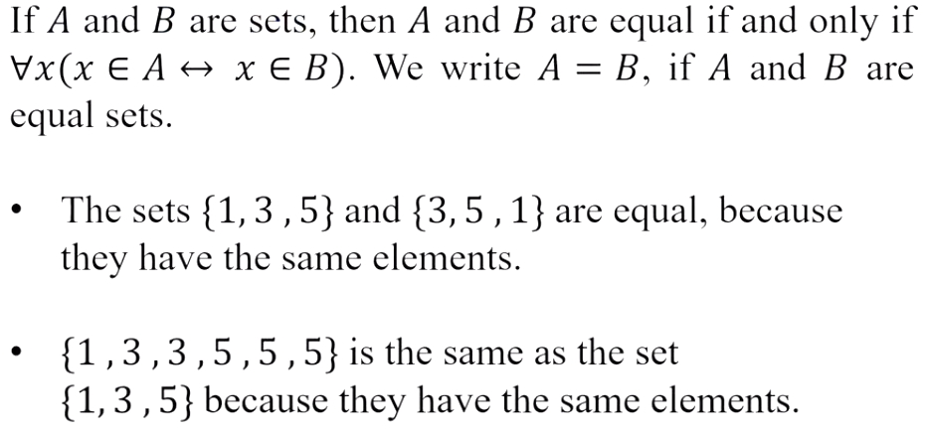
Cont.

Slide 30
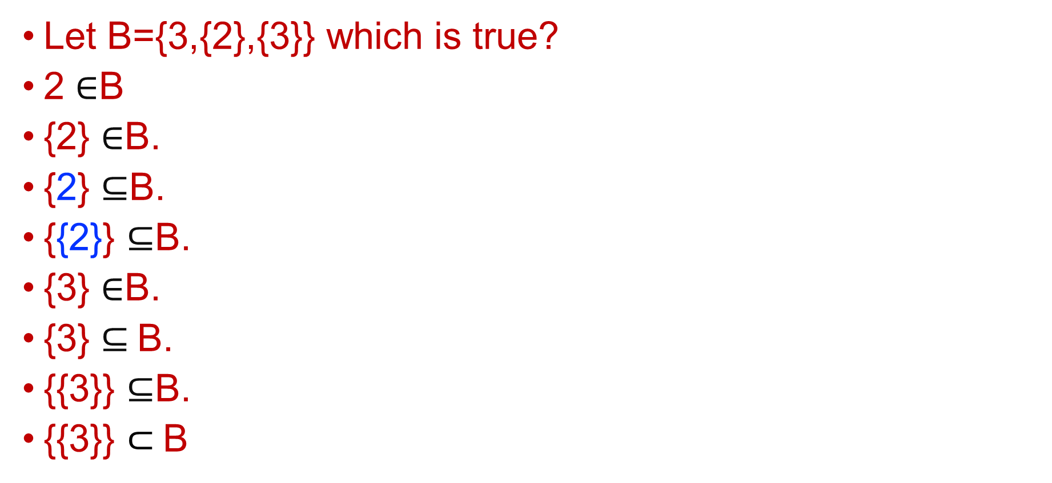

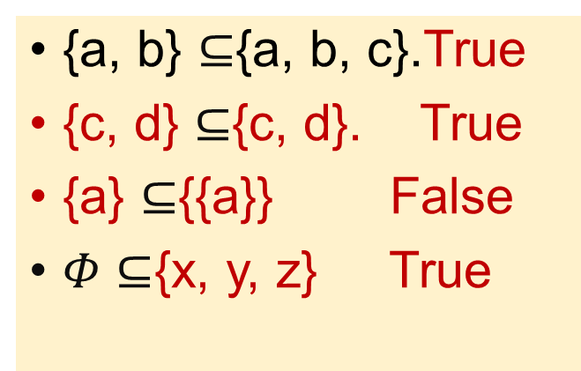
Subset True/False
{a, b} $⊆${a, b, c}.True
{c, d} $⊆${c, d}. True
{a} $⊆${{a}} False
$Φ⊆${x, y, z} True
Let B={3,{2},{3}} which is true?
2 $∈$B
{2} $∈$B.
{2} $⊆$B.
{{2}} $⊆$B.
{3} $∈$B.
{3} $⊆$B.
{{3}} $⊆$B.
{{3}} $⊂$B
Z⁺ $⊆$ Z. true

Slide 31
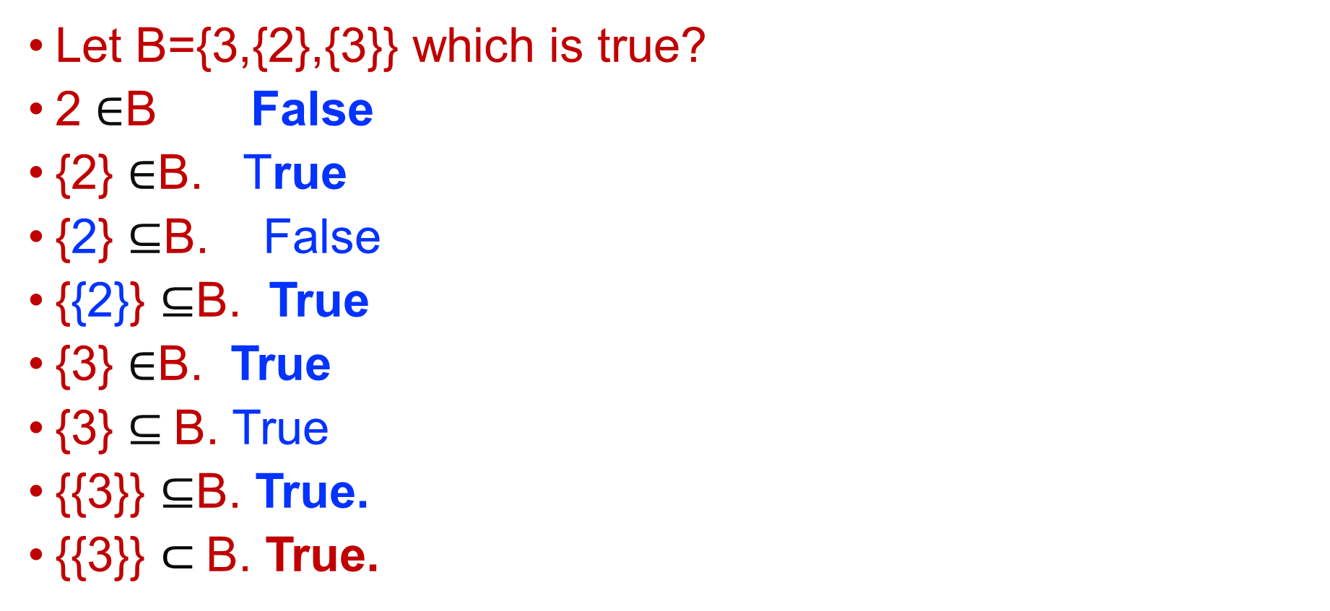

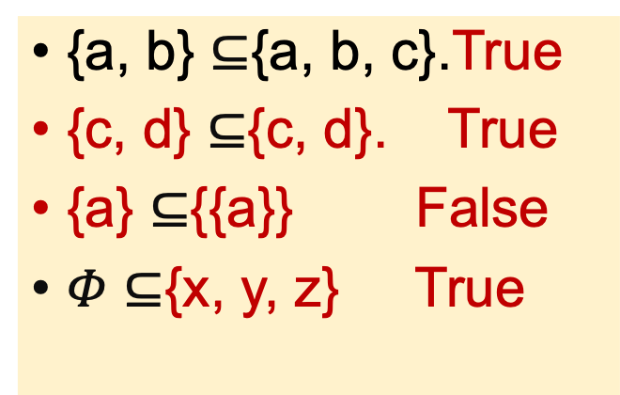
Subset True/False
{a, b} $⊆${a, b, c}.True
{c, d} $⊆${c, d}. True
{a} $⊆${{a}} False
$Φ⊆${x, y, z} True
Let B={3,{2},{3}} which is true?
2 $∈$B False
{2} $∈$B. True
{2} $⊆$B. False
{{2}} $⊆$B. True
{3} $∈$B. True
{3} $⊆$B. True
{{3}} $⊆$B. True.
{{3}} $⊂$B. True.
Z⁺ $⊆$ Z. true

Slide 32

Universal set
Universal set (U) is a set that contains all the elements of interest.
Example: if we are dealing with integer sets, the universal set is the set of all integers.
U
A

Slide 33
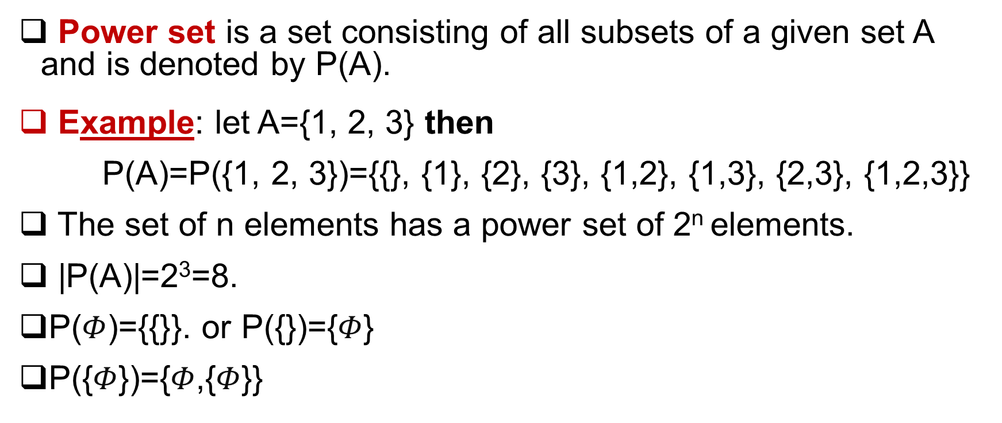
Power set
Power set is a set consisting of all subsets of a given set A and is denoted by P(A).
Example: let A={1, 2, 3} then
P(A)=P({1, 2, 3})={{}, {1}, {2}, {3}, {1,2}, {1,3}, {2,3}, {1,2,3}}
The set of n elements has a power set of 2^{n} elements.
|P(A)|=2³=8.
P($Φ$)={$\text{\{\}}$}. or P({})={$Φ$}
P({$Φ$})={$Φ$,{$Φ$}}

Slide 34
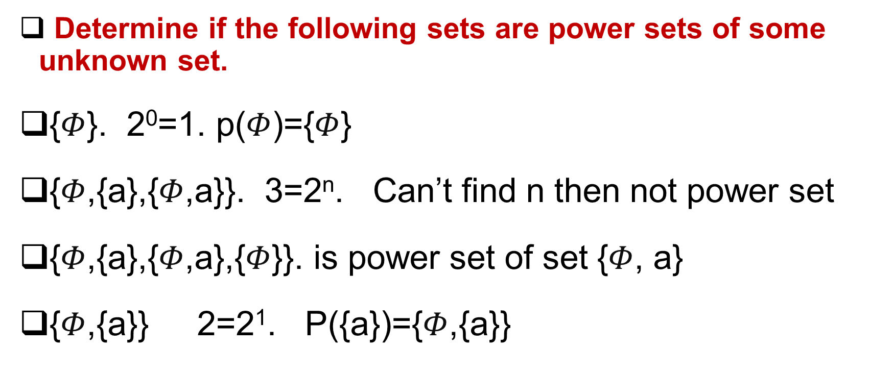
Power set
Determine if the following sets are power sets of some unknown set.
{$Φ$}. 2⁰=1. p($Φ$)={$Φ$}
{$Φ$,{a},{$Φ$,a}}. 3=2^{n}. Can’t find n then not power set
{$Φ$,{a},{$Φ$,a},{$Φ$}}. is power set of set {$Φ$, a}
{$Φ$,{a}} 2=2¹. P({a})={$Φ$,{a}}

Slide 35
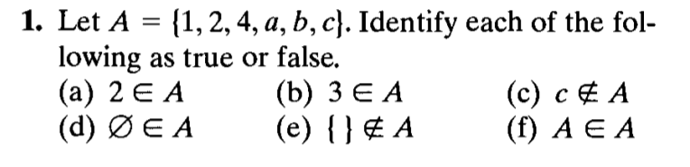
Questions
Answer:
true
False
false
False
True
false

Slide 36
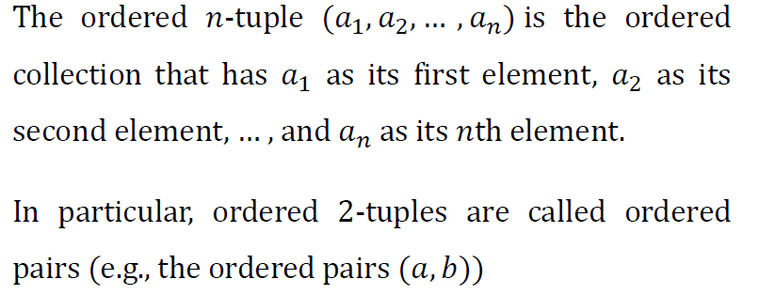
The ordered 𝒏-tuple

Slide 37
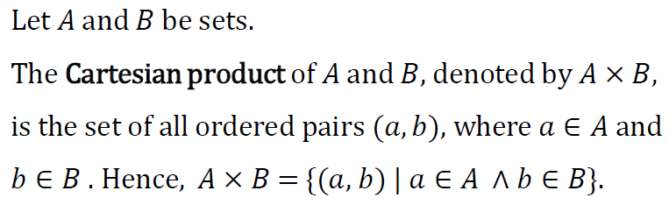
Cartesian Products

Slide 38
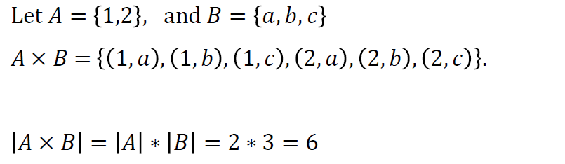
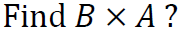
Cartesian Products - Example

Slide 39
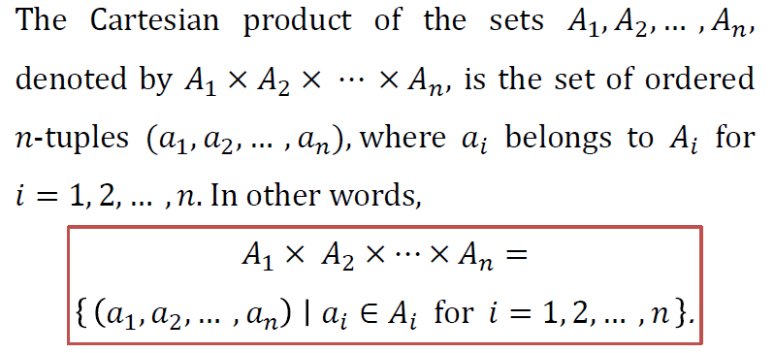
The Cartesian product of more than two sets.

Slide 40
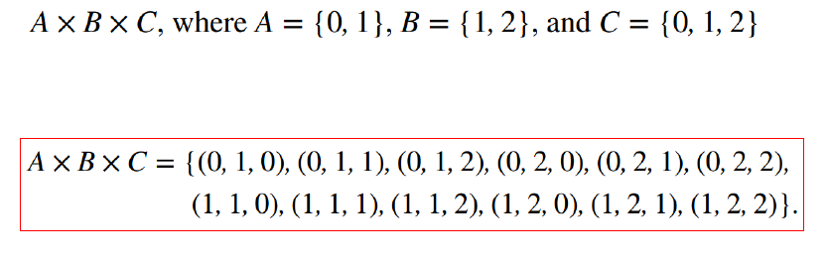
Example

Slide 41
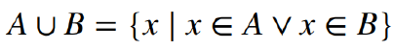
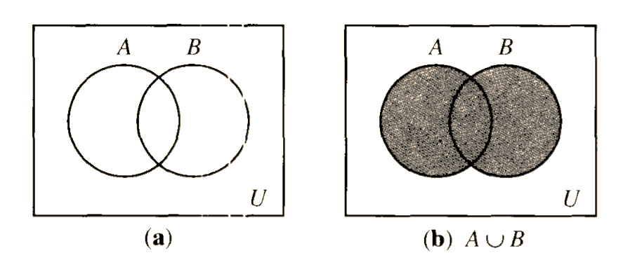
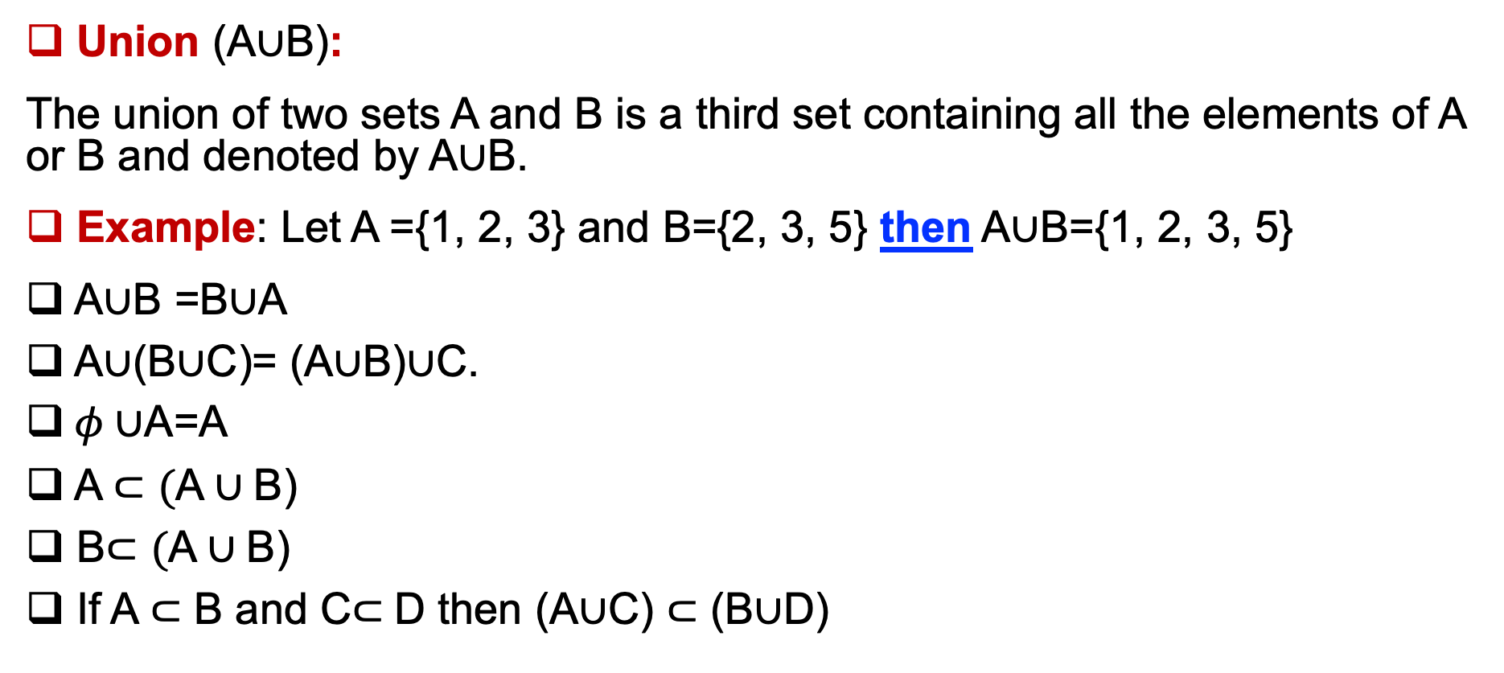
Operations on sets
Union (A$∪$B):
The union of two sets A and B is a third set containing all the elements of A or B and denoted by A$∪$B.
Example: Let A ={1, 2, 3} and B={2, 3, 5} then A$∪$B={1, 2, 3, 5}
A$∪$B =B$∪$A
A$∪$(B$∪$C)= (A$∪$B)$∪$C.
$φ∪$A=A
A$⊂(\text{A}∪\text{B}$)
B$⊂(\text{A}∪\text{B}$)
If A$⊂$ B and C$⊂$D then (A$∪$C) $⊂$ (B$∪$D)

Slide 42
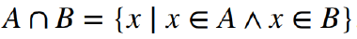
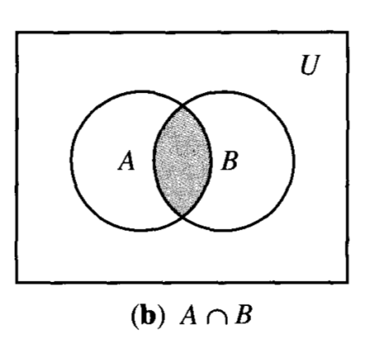
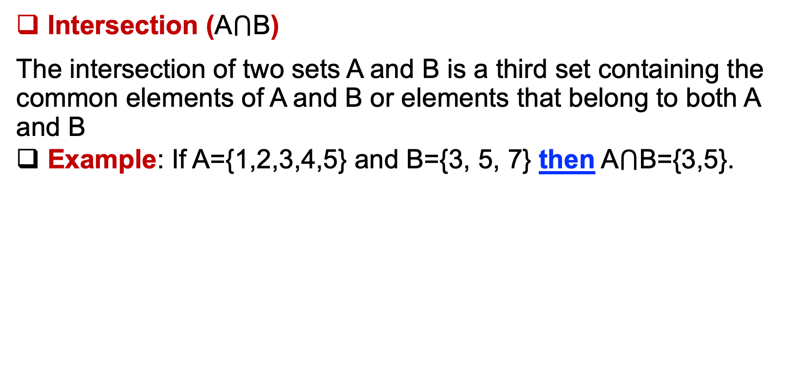
Operations on sets
Intersection (A$⋂$B)
The intersection of two sets A and B is a third set containing the common elements of A and B or elements that belong to both A and B
Example: If A={1,2,3,4,5} and B={3, 5, 7} then A$⋂$B={3,5}.
1
2 4
3
5
7

Slide 43

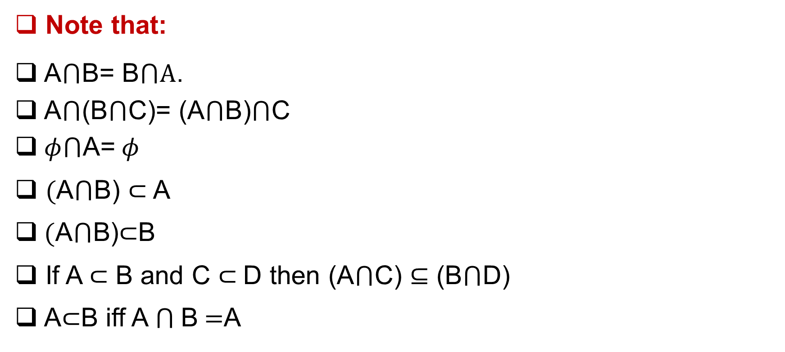
Operations on sets
Note that:
A$⋂$B= B$⋂A$.
A$⋂$(B$⋂$C)= (A$⋂$B)$⋂$C
$φ⋂$A= $φ$
$(\text{A}⋂\text{B}$) $⊂$A
$(\text{A}⋂\text{B}$)$⊂$B
If A$⊂$ B and C $⊂$D then (A$⋂$C) $⊆$ (B$⋂$D)
A$⊂$B iff A $⋂$B $=$A

Slide 44
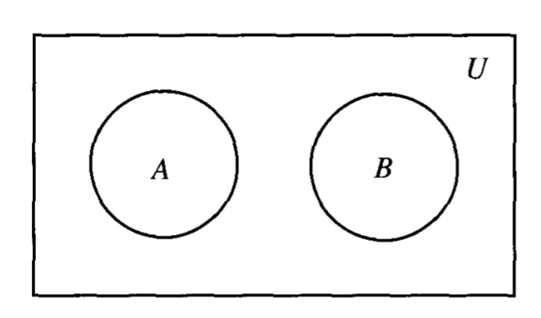
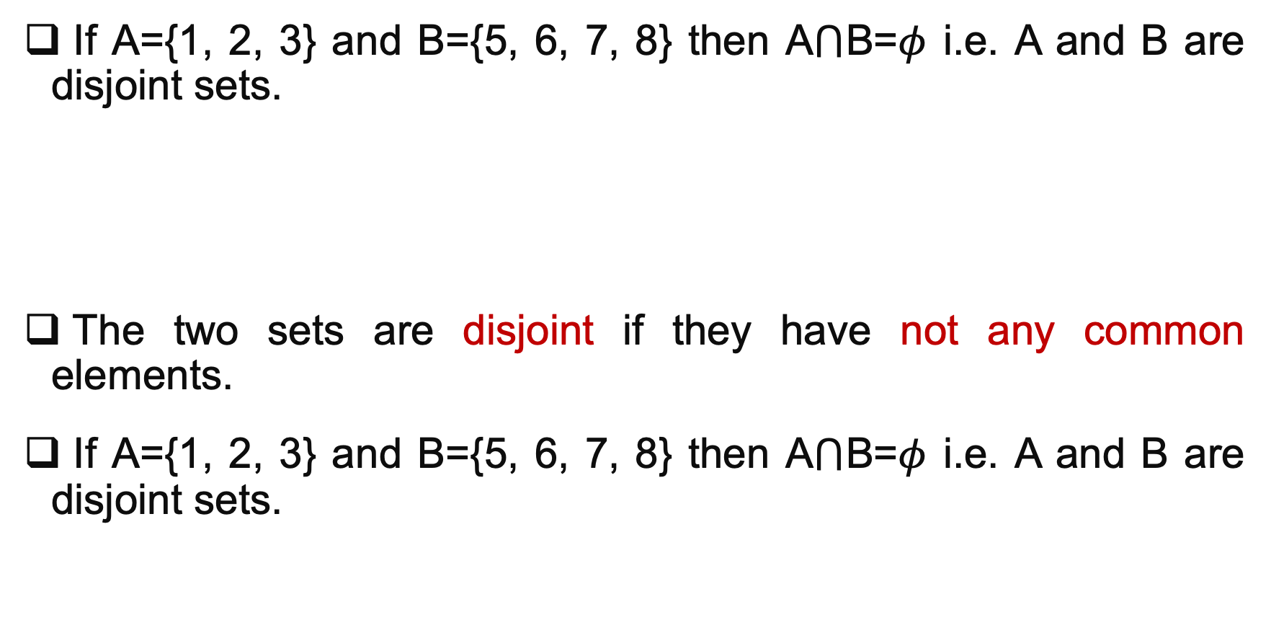
Disjoint sets
If A={1, 2, 3} and B={5, 6, 7, 8} then A$⋂$B=$φ$ i.e. A and B are disjoint sets.
The two sets are disjoint if they have not any common elements.
If A={1, 2, 3} and B={5, 6, 7, 8} then A$⋂$B=$φ$ i.e. A and B are disjoint sets.
2.
6.
B
4.
9. 12.
A

Slide 45
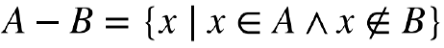
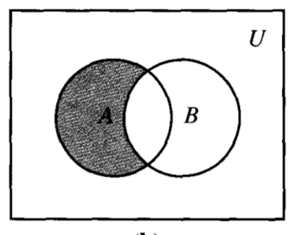
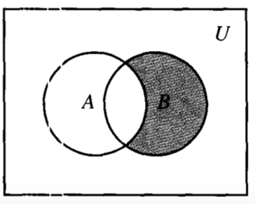
Operations on sets
The difference (A-B) of A and B is a third set containing all of the elements of A which doesn’t exist in B.
Example: Let A ={1, 3, 4, 5, 6}
B={3, 4, 7} then
A-B={1, 5, 6}
B-A={7}
A-B
B-A

Slide 46
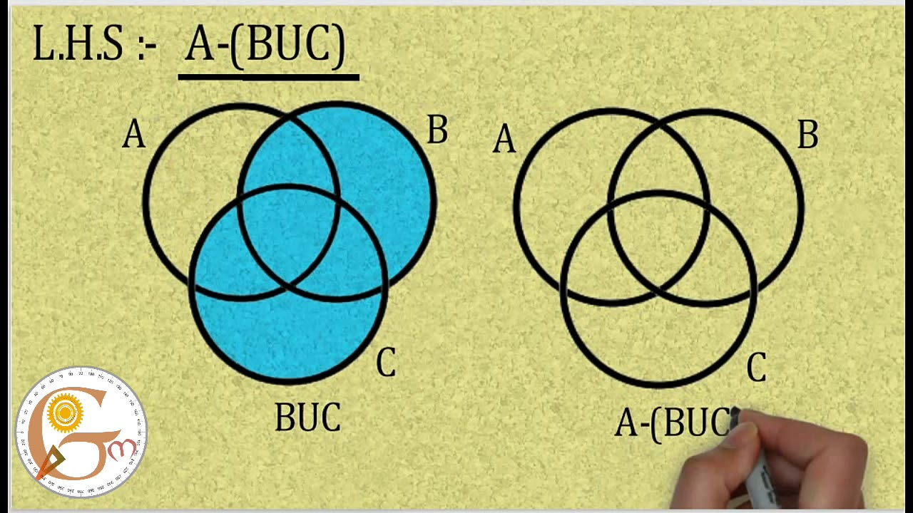
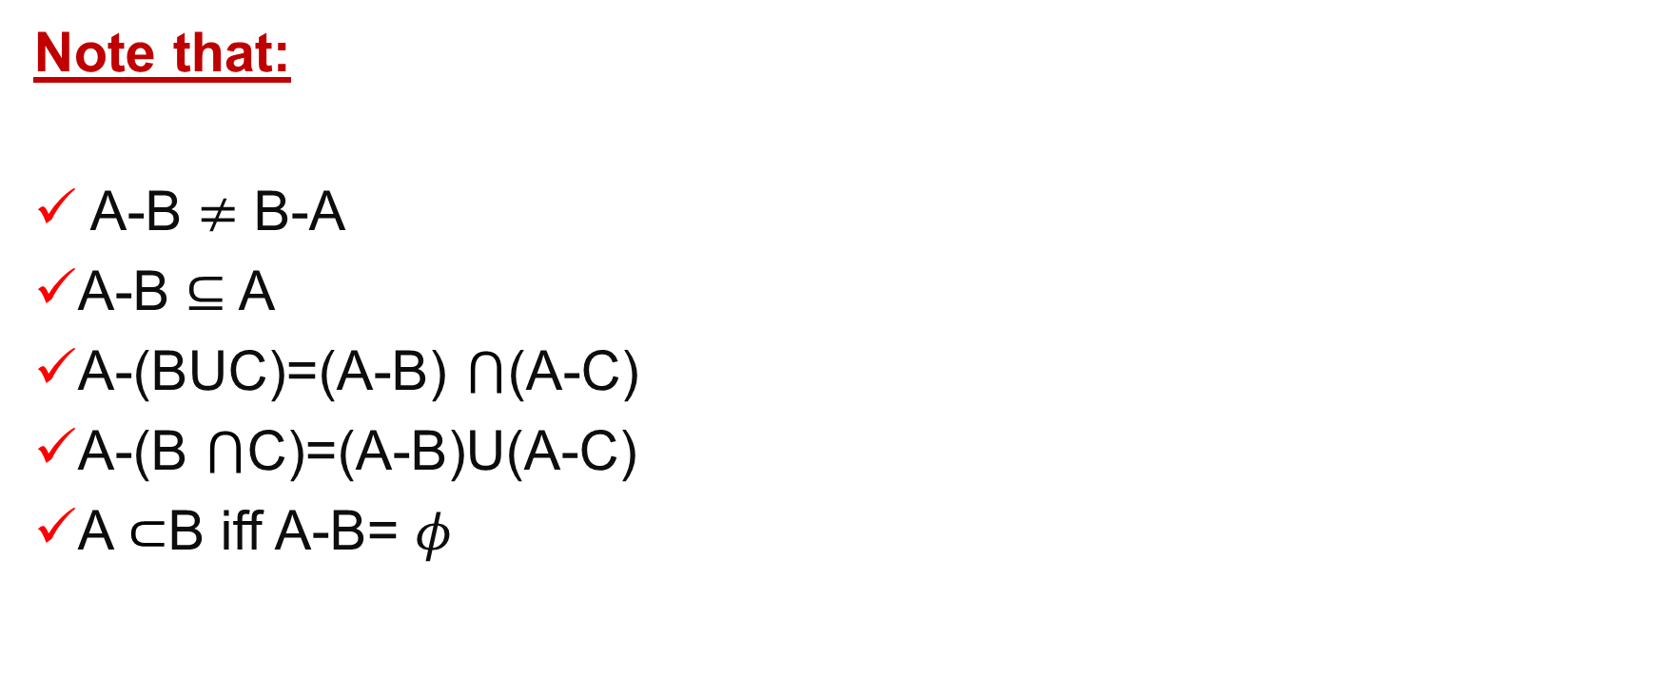
Operations on sets
Note that:
A-B $≠$ B-A
A-B $⊆$ A
A-(BUC)=(A-B) $⋂$(A-C)
A-(B $⋂$C)=(A-B)U(A-C)
A $⊂$B iff A-B= $φ$

Slide 47
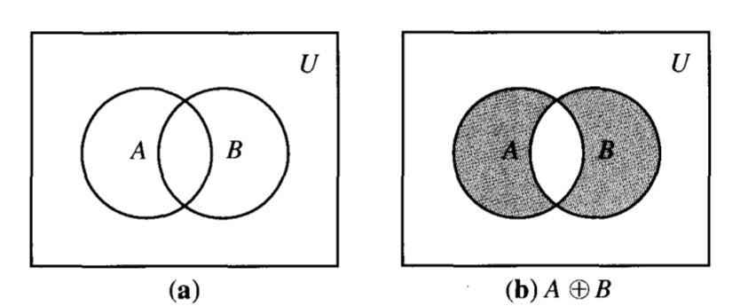
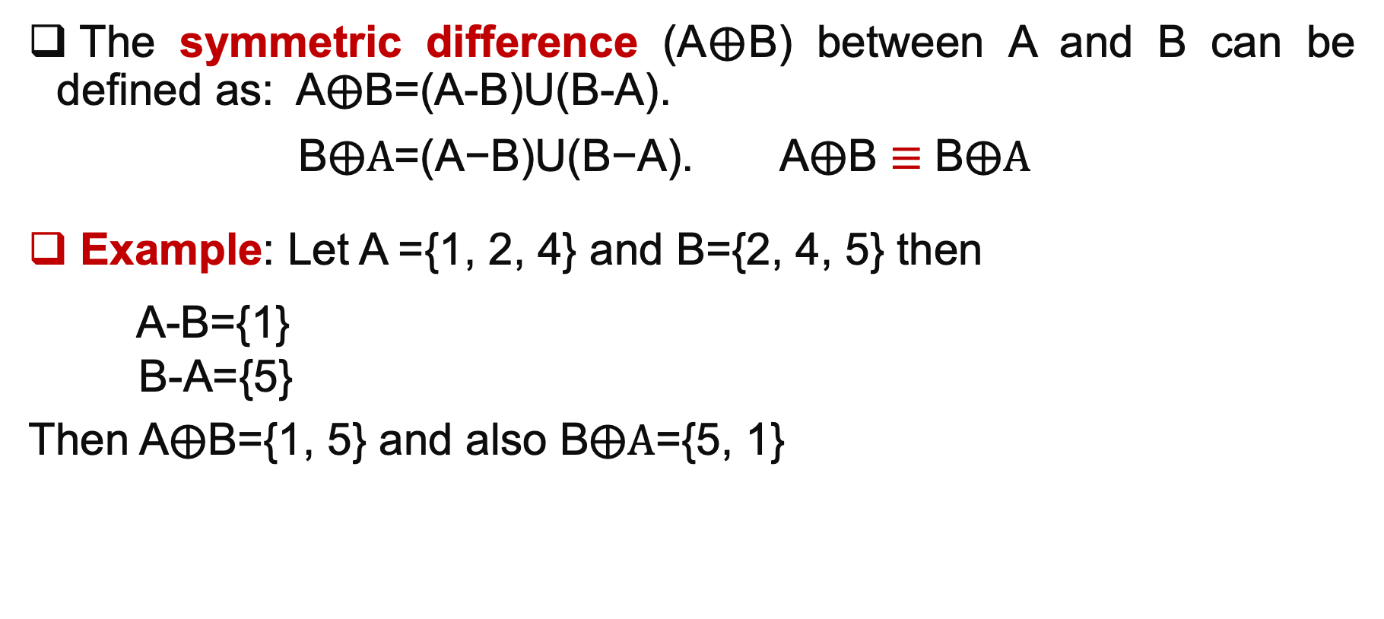
Operations on sets
The symmetric difference (A$⨁$B) between A and B can be defined as: A$⨁$B=(A-B)U(B-A).
B$⨁A\text{=(}\text{A}\text{−}\text{B}\text{)}\text{U}\text{(}\text{B}\text{−}\text{A}\text{).}$ A$⨁$B $≡$ B$⨁A$
Example: Let A ={1, 2, 4} and B={2, 4, 5} then
A-B={1}
B-A={5}
Then A$⨁$B={1, 5} and also B$⨁A\text{=}${5, 1}

Slide 48
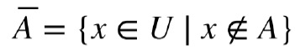
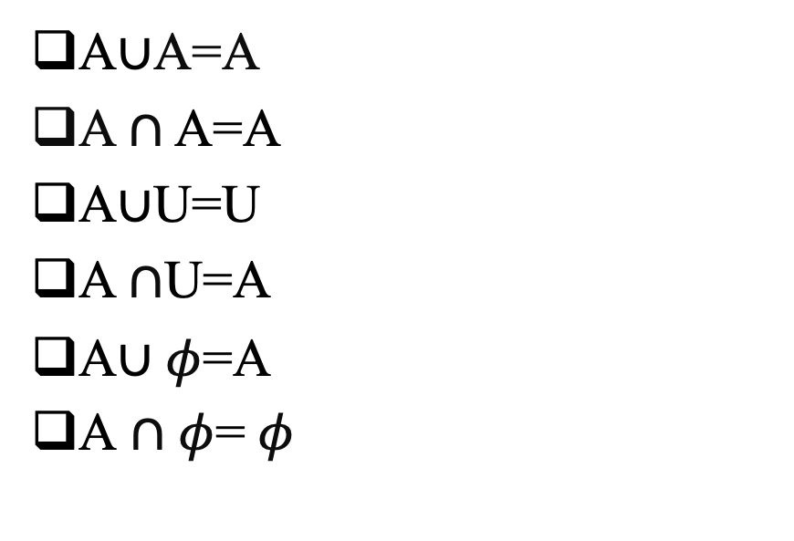
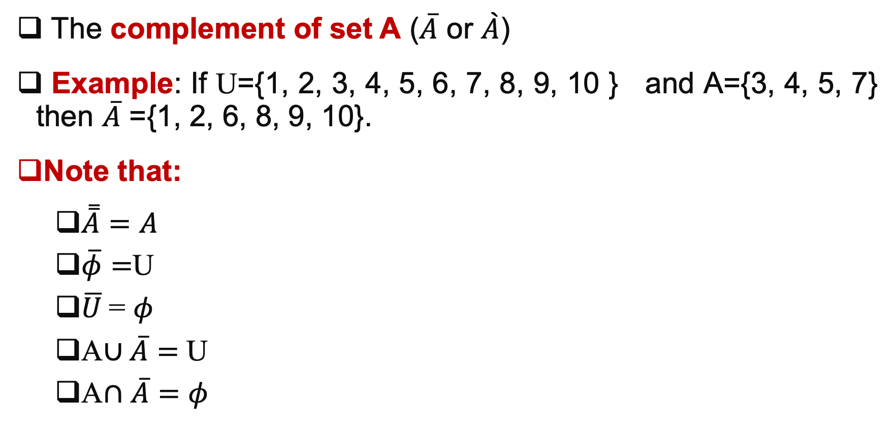
Operations on sets
The complement of set A ($\overline{A}$ or $\grave{A}$)
Example: If U={1, 2, 3, 4, 5, 6, 7, 8, 9, 10 } and A={3, 4, 5, 7} then $\overline{A}$ ={1, 2, 6, 8, 9, 10}.
Note that:
$\overset{̿}{A}=A$
$\overline{φ}=$U
$\overline{U}$= $φ$
A$∪\overline{A}=$ U
A$∩$ $\overline{A}=φ$
A$∪$A=A
A $∩$ A=A
A$∪$U=U
A $∩$U=A
A$∪φ$=A
A $∩$ $φ$= $φ$

Slide 49
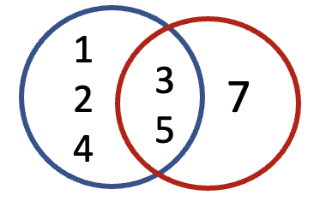
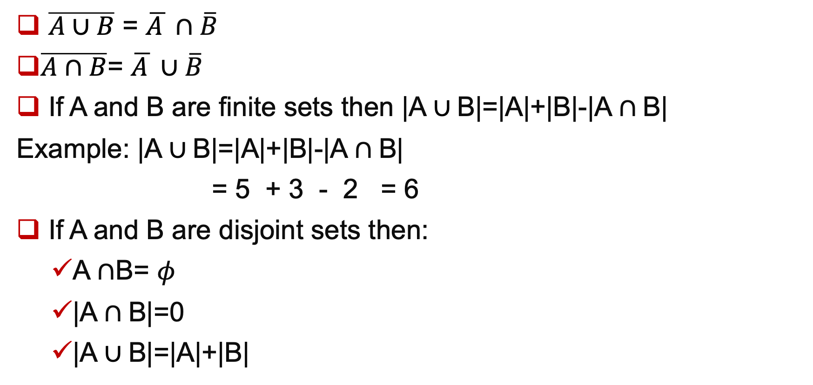
De Morgan’s law
$\overline{A∪B}$ = $\overline{A }∩\overline{B}$
$\overline{A∩B}$= $\overline{A }∪\overline{B}$
If A and B are finite sets then |A $∪$B|=|A|+|B|-|A $∩$B|
Example: |A $∪$B|=|A|+|B|-|A $∩$B|
= 5 + 3 - 2 = 6
If A and B are disjoint sets then:
A $∩$B= $φ$
|A $∩$B|=0
|A $∪$B|=|A|+|B|
A B

Slide 50


If A, B and C are finite sets then
|A$∪$B$∪$C|=|A|+|B|+|C|-|A $∩$B|-|B $∩$C|-|A $∩$C|+|A $∩$B $∩$C|

Slide 51


Example
|X $∪Y∪Z$|= |X| + |Y| + |Z| - |X $∩Y$| -|Y $∩Z$| - |X $∩$Z| +|X $∩Y$ $∩Z|$
= 5+5+5-3-3-3+2=8

Slide 52

Set Identities (1/8)

Slide 53

Set Identities (2/8)

Slide 54

Set Identities (3/8)

Slide 55

Set Identities (4/8)

Slide 56

Set Identities (5/8)

Slide 57

Set Identities (6/8)

Slide 58

Set Identities (7/8)

Slide 59

Set Identities (8/8)

Slide 60

Matrices
A is called square matrix if [A]_{nxn}
Zero matrix is a matrix that has zero entries $\left[\begin{matrix}0 & 0 \\ 0 & 0\end{matrix}\right]$
A.B$≠B.A$
We can perform matrix multiplication when the number of the columns of the first matrix must be equal to the number of rows in the second matrix.
Identity matrix(I)= $\left[\begin{matrix}1 & 0 & 0 \\ 0 & 1 & 0 \\ 0 & 0 & 1\end{matrix}\right]$

Slide 61


Matrices
If A =$\left[\begin{matrix}1 & 2 & 3 \\ 4 & 5 & 6 \\ 7 & 8 & 9\end{matrix}\right]$, then A^{T}= $\left[\begin{matrix}1 & 4 & 7 \\ 2 & 5 & 8 \\ 3 & 6 & 9\end{matrix}\right]$
Note that:
($A^{T}$)^{T}=A
(A+B)^{T}=A^{T}+B^{T}
(AB)^{T}=B^{T}.A^{T}
The matrix is symmetric if A^{T}=A.

Slide 62

Boolean matrix operations
Boolean matrix is a matrix with entries zero or one.
Let A =$\left[\begin{matrix}1 & 0 & 1 \\ 0 & 1 & 1 \\ \begin{aligned}1 \\ 0\end{aligned} & \begin{aligned}1 \\ 0\end{aligned} & \begin{aligned}0 \\ 0\end{aligned}\end{matrix}\right]$, B= $\left[\begin{aligned}1 1 0 \\ 1 0 1 \\ 0 0 1 \\ 1 1 0\end{aligned}\right]$
Compute A$∨$B and A$∧$B.
A$∨$B =$\left[\begin{matrix}1 & 1 & 1 \\ 1 & 1 & 1 \\ \begin{aligned}1 \\ 1\end{aligned} & \begin{aligned}1 \\ 1\end{aligned} & \begin{aligned}1 \\ 0\end{aligned}\end{matrix}\right]$. A$∧$B =$\left[\begin{matrix}1 & 0 & 0 \\ 0 & 0 & 1 \\ \begin{aligned}0 \\ 0\end{aligned} & \begin{aligned}0 \\ 0\end{aligned} & \begin{aligned}0 \\ 0\end{aligned}\end{matrix}\right]$.

Slide 63

Boolean matrix operations
Boolean matrix means mxn matrix with entries zero or one.
Let A =$\left[\begin{aligned}1 1 0 \\ 0 1 0 \\ 1 1 0 \\ 0 0 1\end{aligned}\right]$, B= $\left[\begin{aligned}1 0 0 0 \\ 0 1 1 0 \\ 1 0 1 1\end{aligned}\right]$
Compute Boolean product of A and B.
A$⨀$B=$\left[\begin{aligned}\left(1∧1\right)⋁\left(1∧0\right)⋁\left(0∧1\right) \left(1∧0\right)⋁\left(1∧1\right)⋁\left(0∧0\right) \left(1∧0\right)⋁\left(1∧1\right)⋁\left(0∧1\right) \left(1∧0\right)⋁\left(1∧0\right)⋁(0∧1) \\ \left(0∧1\right)⋁\left(1∧0\right)⋁\left(0∧1\right) \left(0∧0\right)⋁\left(1∧1\right)⋁\left(0∧0\right) \left(0∧0\right)⋁\left(1∧1\right)⋁\left(0∧1\right) \left(0∧0\right)⋁\left(1∧0\right)⋁(0∧1) \\ \left(1∧1\right)⋁\left(1∧0\right)⋁\left(0∧1\right) \left(1∧0\right)⋁\left(1∧1\right)⋁\left(0∧0\right) \left(1∧0\right)⋁\left(1∧1\right)⋁\left(0∧1\right) \left(1∧0\right)⋁\left(1∧0\right)⋁(0∧1) \\ \left(0∧1\right)⋁\left(0∧0\right)⋁\left(1∧1\right) \left(0∧0\right)⋁\left(0∧1\right)⋁\left(1∧0\right) \left(0∧0\right)⋁\left(0∧1\right)⋁\left(1∧1\right) \left(0∧0\right)⋁\left(0∧1\right)⋁\left(1∧1\right)\end{aligned}\right]$
= $\left[\begin{aligned}1 1 1 0 \\ 0 1 1 0 \\ 1 1 1 0 \\ 1 0 1 1\end{aligned}\right]$

Slide 64

Boolean product of two matrices

Slide 65


Slide 66


Slide 67


b. Suppose A= $\left[\begin{matrix}1 & 0 & 1 \\ 1 & 0 & 0 \\ 0 & 1 & 1\end{matrix}\right]$ and B =$\left[\begin{matrix}1 & 0 & 0 \\ 0 & 1 & 0 \\ 1 & 0 & 1\end{matrix}\right]$ .
Find
(a) A ˄ B. (b) A ˅ B. (c) A⨀B.
Q8: a. Suppose A= $\left[\begin{matrix}0 & 1 & 0 \\ 1 & 0 & 1 \\ 0 & 1 & 0\end{matrix}\right]$ B= $\left[\begin{matrix}1 & 0 & 1 \\ 0 & 0 & 0 \\ 1 & 1 & 0\end{matrix}\right]$
Find :
(a) A ˄ B. (b) A ˅ B. (c) A⨀B.

Slide 68
Sequence
Sequence is a list of objects arranged in a definited order.
Finite sequence 1, 3, 5, 7
Infinite sequence. 3, 8, 13, 17, …

Slide 69
Sequence vs. set
A set has no order and no duplicated elements.
A sequence has a specific order and elements may be duplicated.
1, 2, 3, 2, 2, 3, 1 is a sequence but not a set.
The sequence is 1, 2, 3, 2, 2, 3, 1 and 2, 3, 1, 2 is made of the set {1, 2, 3}.
In strings: Sequences can be made up of characters. Ex. W, a, k, e, ,u, p
The string Wake up is made of the sequence W, a, k, e, ,u, p and the set {w, a, k, e, , u, p}

Slide 70

Questions
{1,2}
{x|x is an even number}
{a,b,c,d,e,…,z}
{a,b,c,d}

Slide 71

Formula
Formula is used to describe a sequence:
1. Recursive formula:
Every recursive formula must include a starting place.
The next term is determined from a previous value.
Sequence: 3, 8, 13, 18, …
recursive formula: a₁=3. a_{n}=a_{n-1}+5. 1<n<$∞$
Sequence: 1, 2, 3, 5, 8, …
recursive formula: a₁=1. a₂=2. a_{n}=a_{n-1}+a_{n-2}. 1<n<$∞$

Slide 72

Formula
2. Explicit formula
Describes a term using only its position number.
Sequence: 2, 4, 6, 8
Explicit formula: a_{n}=2n. 1$≤n≤4$
Recursive formula: a₁=2. a_{n}=a_{n-1}+2. 1 $≤$n $≤ 4$
Sequence: 1, 3, 5. 7
Explicit formula: a_{n}=2n-1. 1$≤n≤4$
Recursive formula: a₁=1. a_{n}=a_{n-1}+2. 1 $≤$n $≤ 4$

Slide 73



Questions
Answer

Slide 74

Examples
1, -1, 1,-1,1,…
Explicit formula: a_{n}=(-1)^{n+1}
Recursive formula: a₁=1, a_{n}=-a_{n-1}
1, 1/2, 1/3, 1/4, ….
Explicit formula: a_{n}= 1/n.
Recursive formula: a₁=1, a_{n}=($\frac{1}{\text{a}\text{n}\text{−}\text{1}}+1$)⁻¹
1,1/3,1/5,….
Explicit: a_{n}=1/(2n-1)
Recursive: a₁=1, a_{n}=(a_{n-1}+2)^{-1.} or a_{n}=1/(a_{n-1}+2)

Slide 75

Questions
5, 9, 13, 17, 21, …
a_{n}=4n+1
a₁=5, a_{n}=a_{n-1}+4
3, 3, 3, 3, …
a₁=3, a_{n}=a_{n-1}
15, 20, 25, 30, 35, …
a_{n}=5(n+2)
1, 0.9, 0.8, 0.7, 0.6, …
a_{n} =1 - $\frac{n−1}{10}$

Slide 76
Questions
1, 1/3, 1/5, 1/7, 1/9, …
a_{n}=1/(2n-1)
a₁=1, a_{n}=1/(a_{n-1}+2)
2, 0, 2, 0, …
a_{n}=1+(-1)^{n+1}

Slide 77
Representation of set on computer (Characteristic function)
A set (A) is always defined in a computer program with respect to an underlying universal set (U).
The set A is represented in a computer as a string of binary digits b₁b₂ ... b_{n} where n is the cardinality of the universal set.
b_{i} =1 if i^{th} element of U is in A b_{i} =0 if i^{th} element of U is not in A
For example, if U = {1, 2, 3,4, 5, 6, 7, 8, 9, 10} then the representation of M = {1, 2, 5, 8} is given by string 1100100100.

Slide 78

Characteristic function
The characteristic function of set A can be defined as:
F_{A}=$\left\{\begin{aligned}1 if x∈A \\ 0 if x∉A\end{aligned}\right.$
Note that: F_{A}$∩$_{B}= F_{A.} F_{B}
F_{A} $∪$_{B} = F_{A} + F_{B} - F_{A.} F_{B}
F_{A}$⨁$_{B}= F_{A}+ F_{B}- 2F_{A}.F_{B}
It represents a set in a computer, the elements of the set must be arranged in a sequence.

Slide 79

Sequence
Let U={1, 2, 3, 4, 5, 6}
A={1, 2}
B={2, 4, 6}
C={4, 5, 6}
F_{A}=1,1,0,0,0,0, F_{B}=0,1,0,1,0,1, F_{C}=0,0,0,1,1,1
F_{A}$∩$_{B}= F_{A} .F_{B}=0,1,0,0,0,0
F_{A} $∪$_{B} = F_{A} + F_{B} – F_{A}.F_{B}= 1,2,0,1,0,1 - 0,1,0,0,0,0= 1,1,0,1,0,1
F_{A}$⨁$_{B}= F_{A}+ F_{B}- 2F_{A}.F_{B}= 1,2,0,1,0,1- 2(0,1,0,0,0,0)
= 1,2,0,1,0,1- 0,2,0,0,0,0 =1,0,0,1,0,1
Another method: F_{A}$⨁$_{B}=(A-B)100000 $∪$ (B-A)000101=100101

